Slide 1
Predicting Rainfall Using Machine Learning
Varun Kandukuri
Sahana Bhat
Malvika Mohan
Prathamesh Mahankal

Slide 2
Introduction
It’s spring break!
If you had vacation plans for Australia, this presentation is for you!
We used a dataset with attributes describing the weather conditions for different locations in Australia to determine their effect on rainfall. So if you’re planning to book tickets to Melbourne, have a look at our dashboard first.

Slide 3
Data Collection & Cleaning
We obtained our dataset from Kaggle - Australia Rainfall Dataset (https://www.kaggle.com/jsphyg/weather-dataset-rattle-package)
Removed missing values
Parameters we used to analyse the weather conditions in Australia :
1. Location
2. Temperature Conditions - Minimum Temperature and Maximum Temperature ( celsius)
3. Rainfall (mm)
4. Sunshine
5. Humidity at 9am and 3pm (percent)
6. Wind Speed At 9am and 3pm (km/hr)
7. Cloud Cover at 9am and 3pm

Slide 4
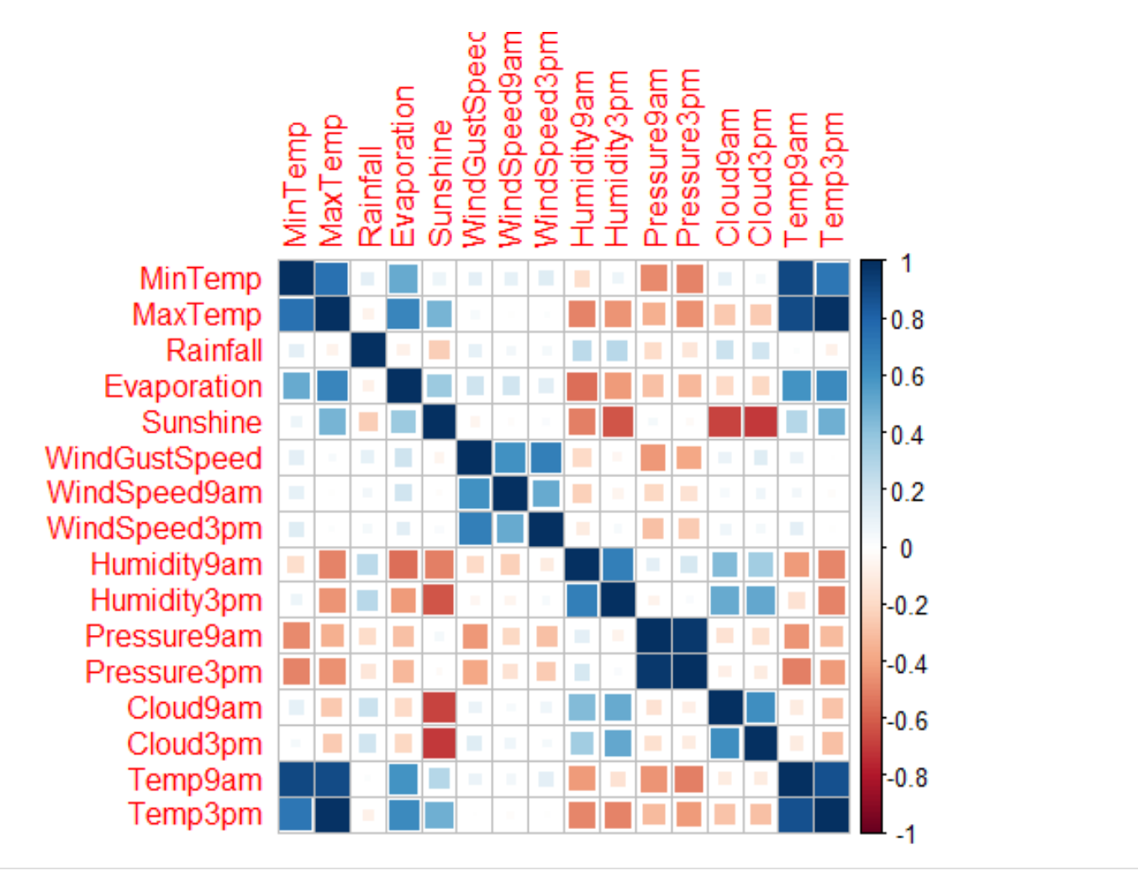
Data Exploration

Slide 5
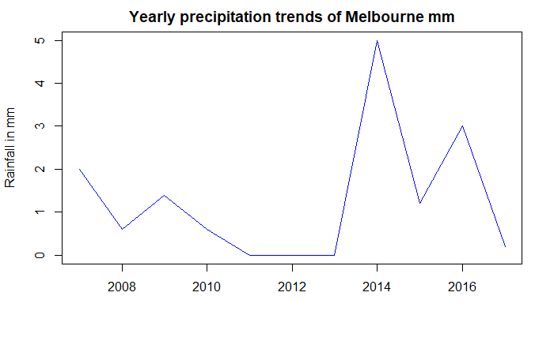
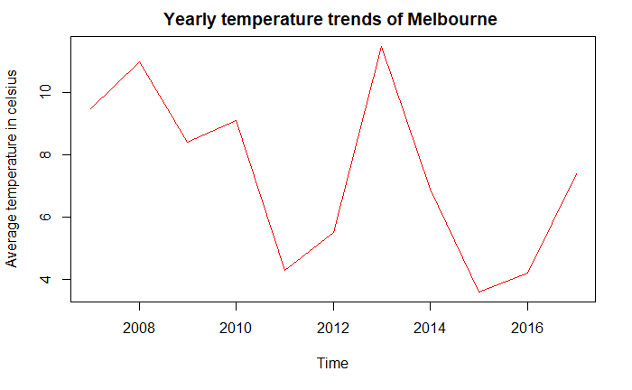
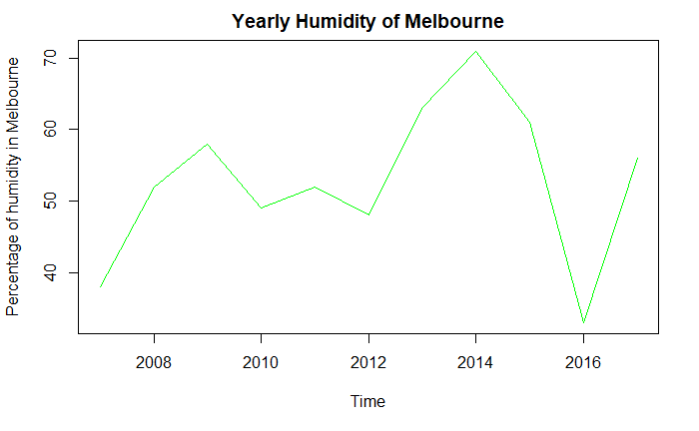
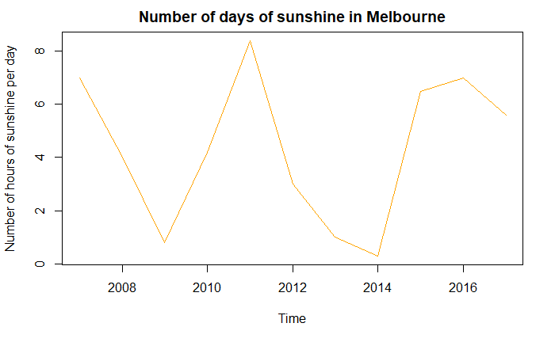
Time Series Analysis Of Melbourne

Slide 6
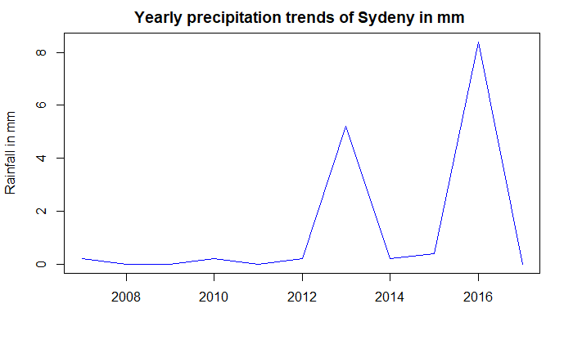
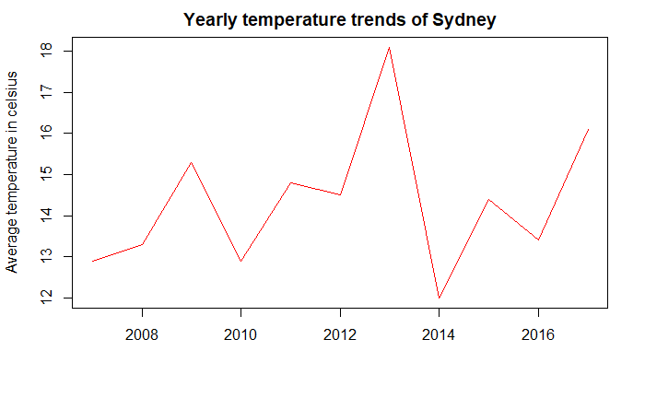
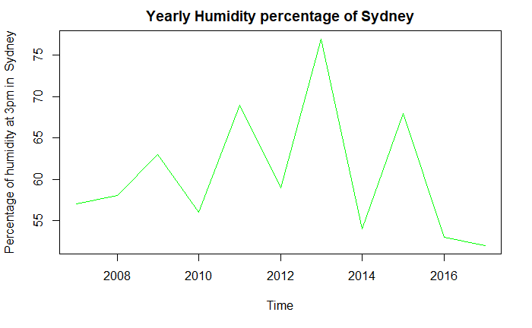
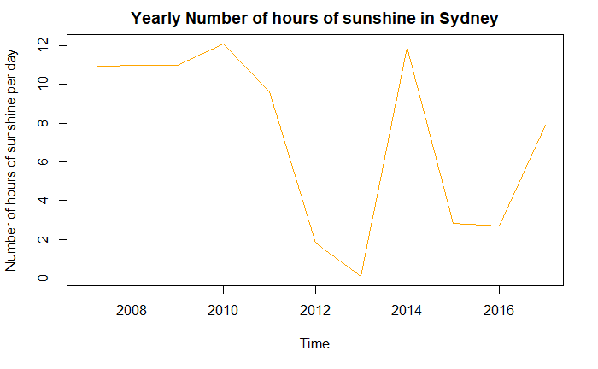
Time Series Analysis Of Sydney

Slide 7
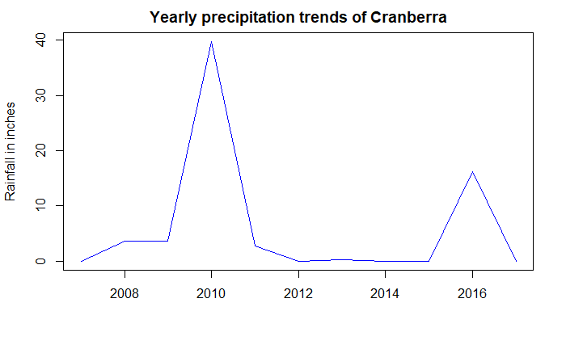
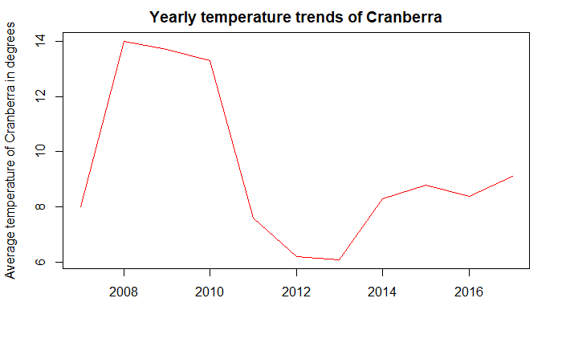
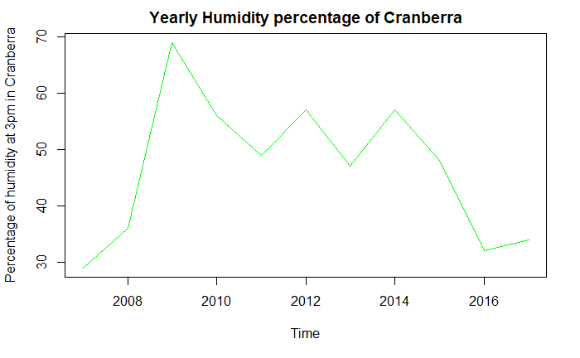
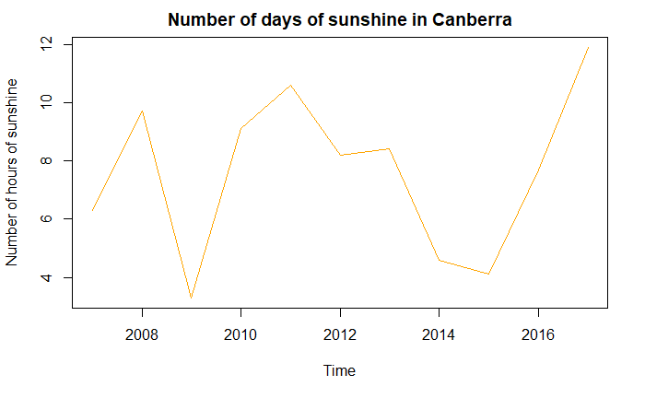
Time Series Analysis Of Canberra

Slide 8
Rainfall vs Significant Variables
Found the best subset of variables that significantly affect Rainfall
Used the BestAIC method for finding the best features
Results : On running the best subset feature, the following variables were found to be significant to rainfall :
Humidity
Sunshine
Wind Speed
Cloud Cover at 3pm
Maximum Temperature
Evaporation

Slide 9
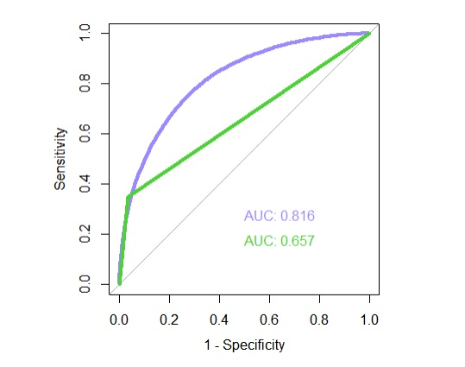
Classification Approach
Logistic vs SVM
Why These Models?
Classification
Binary Class Response
Logistic - Purple
SVM - Green

Slide 10
Metrics for Model Comparison
Since there is a class imbalance for the response variable, a metric like Accuracy would not be a correct measure.
Thus, we will instead be using a metric like Recall, Precision or Kappa Estimate.
For our model, the Sensitivity obtained for the logistic regression model was 0.9475, while that of SVM was 0.9643

Slide 11
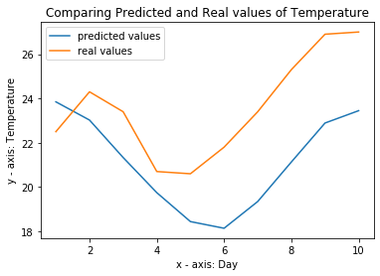
Forecasting Temperature with RNN
Recurrent Neural Networks RNN is used to predict a future outcome based on the previous sequential inputs.
Here, RNN model was build to predict Max Temperature of next 10 days.
The predicted values and the Real measured values are plotted to compare as shown.
Mean Absolute Error = 2.7250645065307615
RMSE = 2.986768870963694

Slide 12
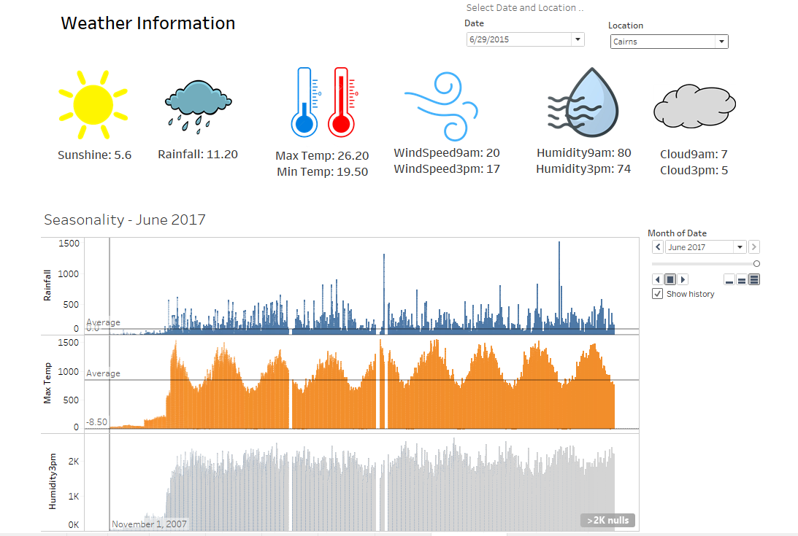
Let’s Create A Dashboard!

Slide 13
Conclusion
We collected data and cleaned it (removed nulls).
We then explored our data to check for correlation
Feature Selection to select best features
Case Study - The Classification Approach with Model Comparison
Dashboard For Weather Analysis

Slide 14
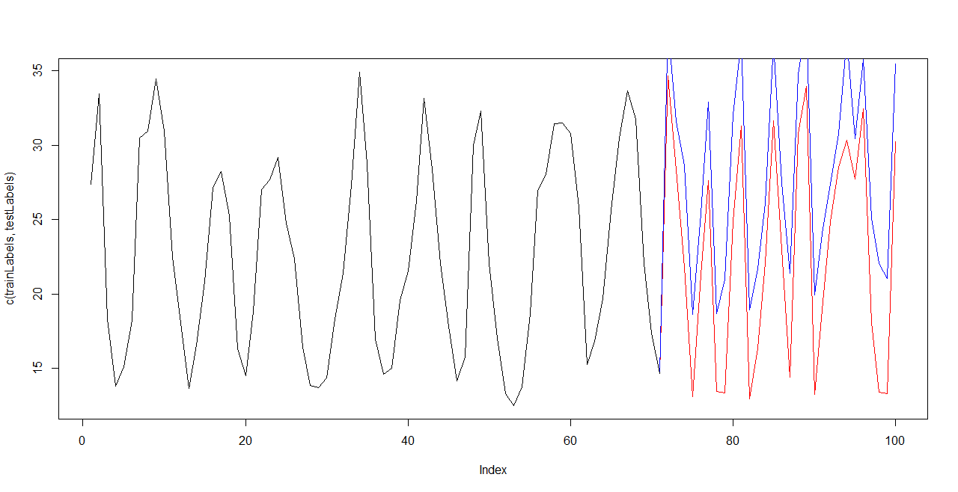
Future Prospects
Counterfactuals using Reinforcement Learning

Slide 15
Any Questions?

